Slide 1

PERFORMANCE AND EVALUATION
OF COMPUTER SYSTEMS AND NETWORKS
5G Connected High-Speed Train
Students:
Sebastiano Pala
Eleonora Sgorbini
ACADEMIC YEAR 2025/2026

Slide 2
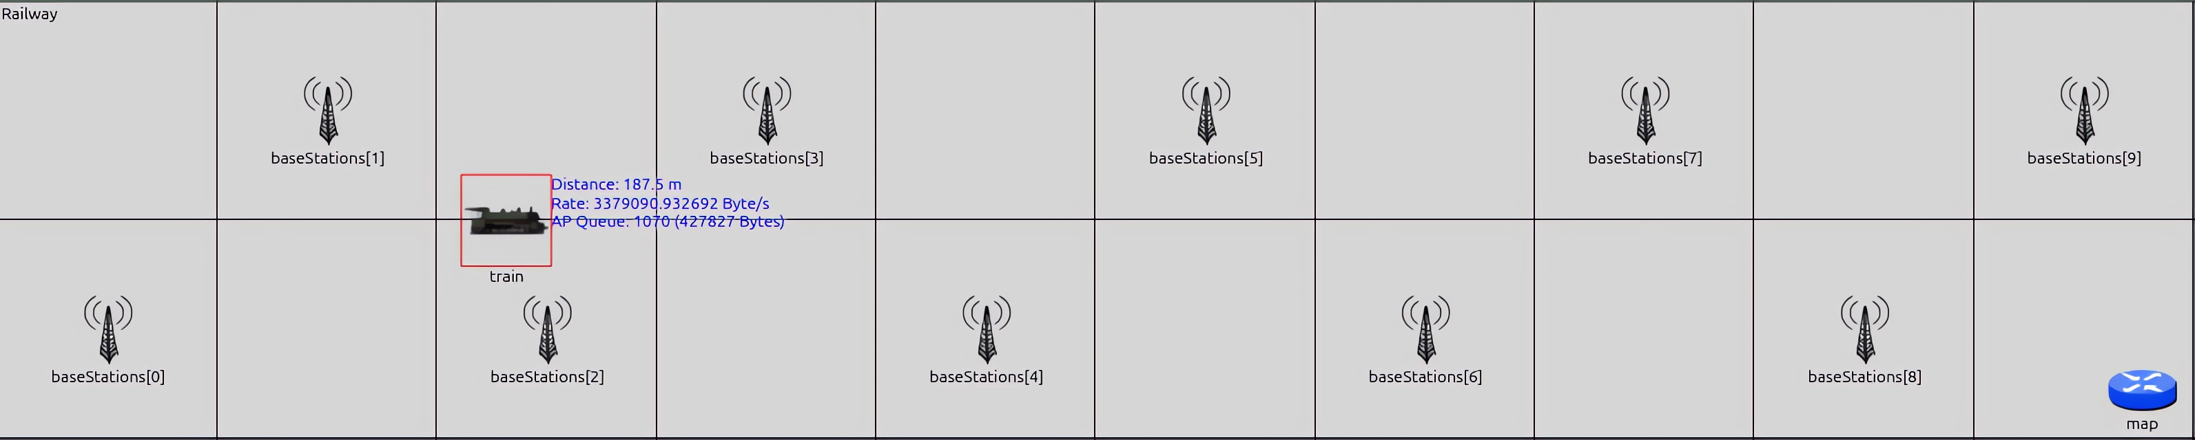
Description of the system
Factor:
N: Number of Passengers
M: Number of Base Stations
H: Mean Handover Delay (s)
Parameters:
S: Mean packet size (Bytes)
T: Mean generation time of the packets (s)
C: Maximum transmission rate (Bytes/s)
V: Train Speed (km/h)
L: Railway length fixed to 10 km
Performance Indexes:
Throughput (Byte/s)
Response Time (s)

Slide 3
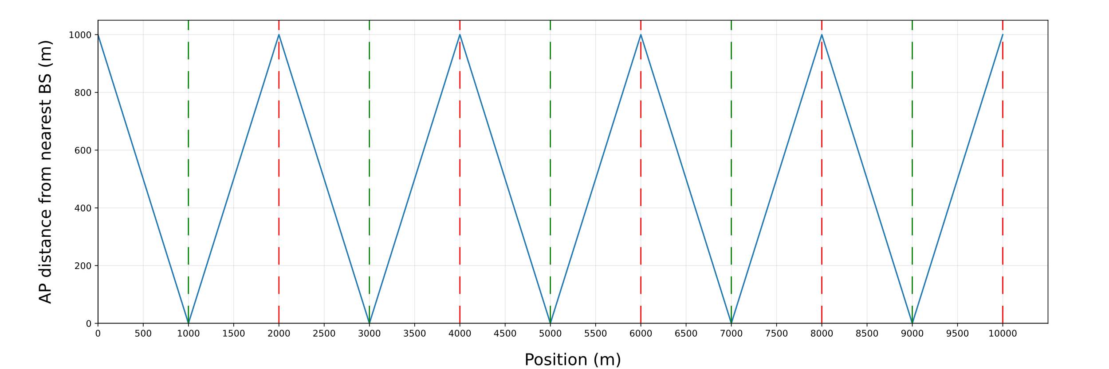
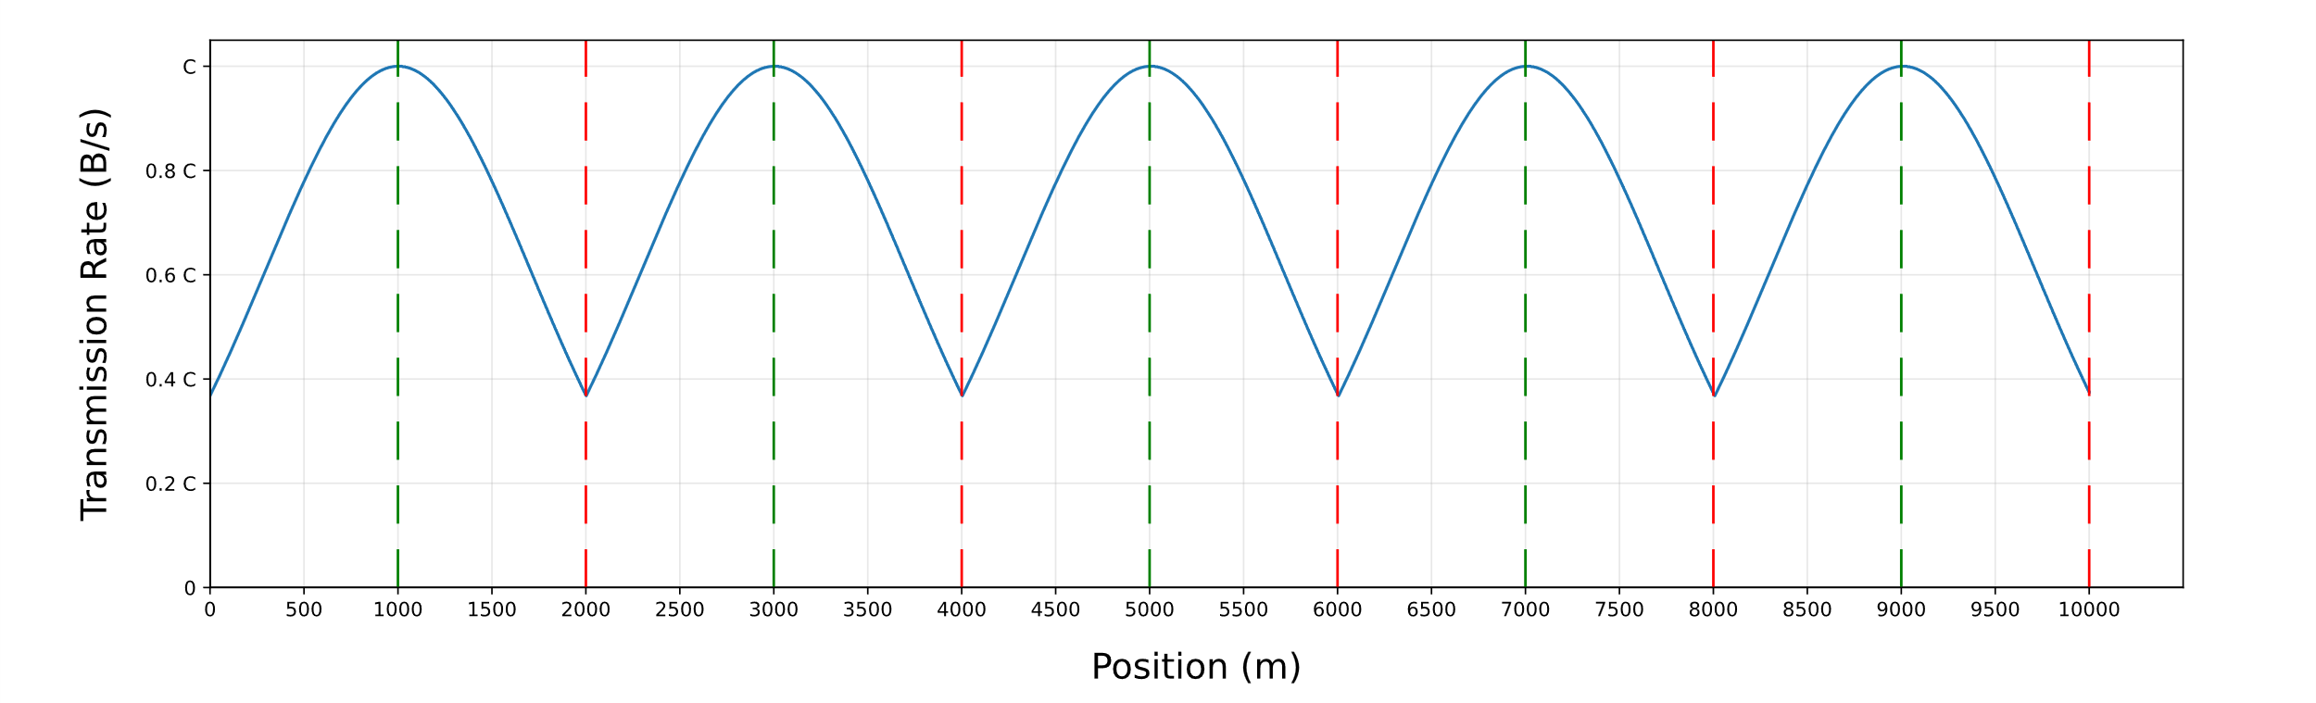
Modelling
GENERAL ASSUMPTION
The propagation delay between the Access Point and a Base Station is considered equal to zero
The transmission time is calculated using the rate at the instant the transmission starts, and remains unchanged regardless of how the rate changes afterwards (due to the distance)
The Access Point's queue is assumed to be infinite
We have chosen to use a uniform random variable to represent the handover delay

Slide 4
Implementation
RAILWAY NETWORK
Modules
Base station: simple module which models one of the entry points of the 5G radio network. All the base stations are evenly spaced along the railway
Mapper: simple module which models an omniscient entity that knows all the base stations' positions
Train: compound module which models the moving vehicle. This module contains:
Passenger: simple module which models one of the N passengers
Access Point: simple module which acts as a bridge between the passengers and the base station by receiving, storing and forwarding packets
Simple Mobility: simple module which updates the train's position
Debug Module: simple module which prints out values during the graphical simulation for debug purposes. It has no effect on the simulation

Slide 5
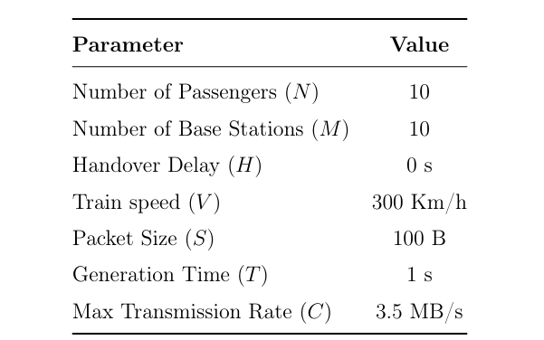
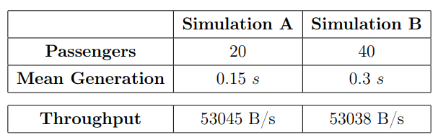
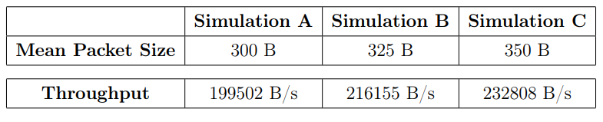
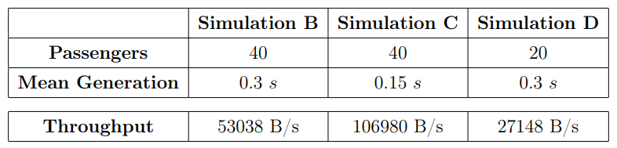
Verification
Deterministic Test
Degeneracy Tests
M = 0 (No Base Stations)
V = 0 (No Train speed)
N = 0 (No Passengers)
C = 0 (Max Rate = 0)
H = 0 (No Handover)
Consistency Test
Continuity Test

Slide 6
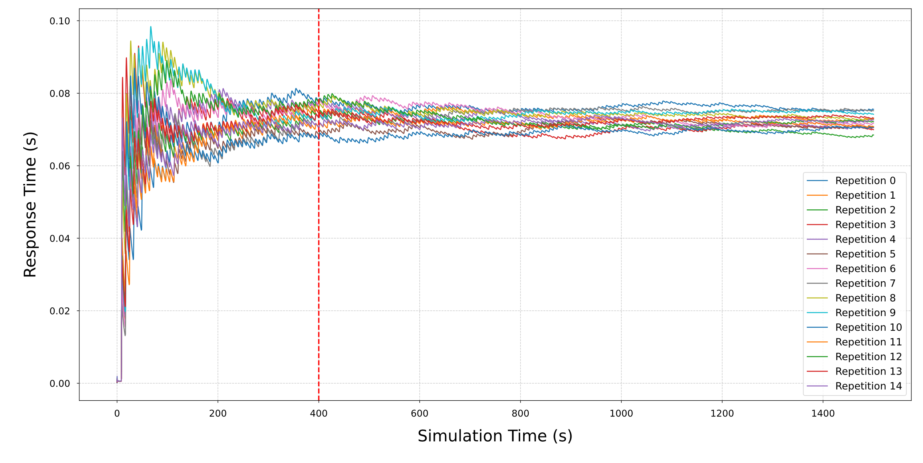
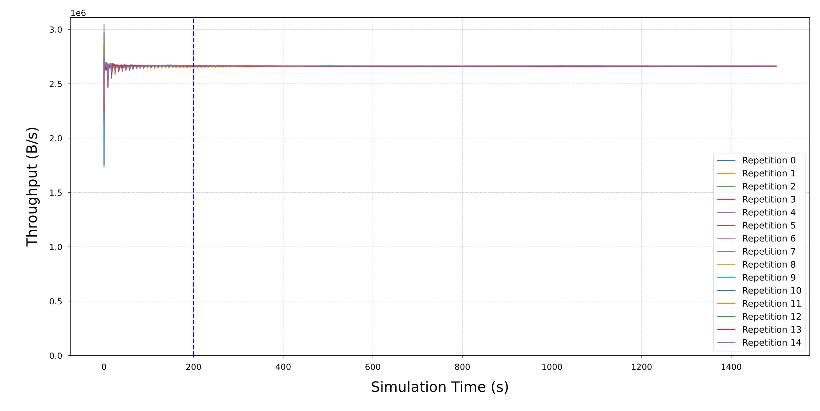
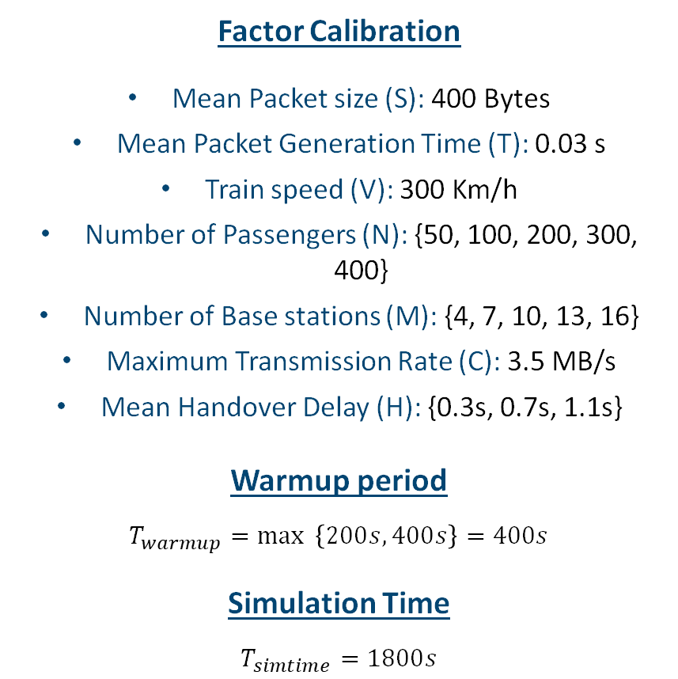
Calibration
Factor Calibration
Mean Packet size (S): 400 Bytes
Mean Packet Generation Time (T): 0.03 s
Train speed (V): 300 Km/h
Number of Passengers (N): {50, 100, 200, 300, 400}
Number of Base stations (M): {4, 7, 10, 13, 16}
Maximum Transmission Rate (C): 3.5 MB/s
Mean Handover Delay (H): {0.3s, 0.7s, 1.1s}
Warmup period
$$T_{warmup}=\max{ \left\{200s, 400s\right\}}=400s$$
Simulation Time
$$T_{simtime}=1800s$$

Slide 7
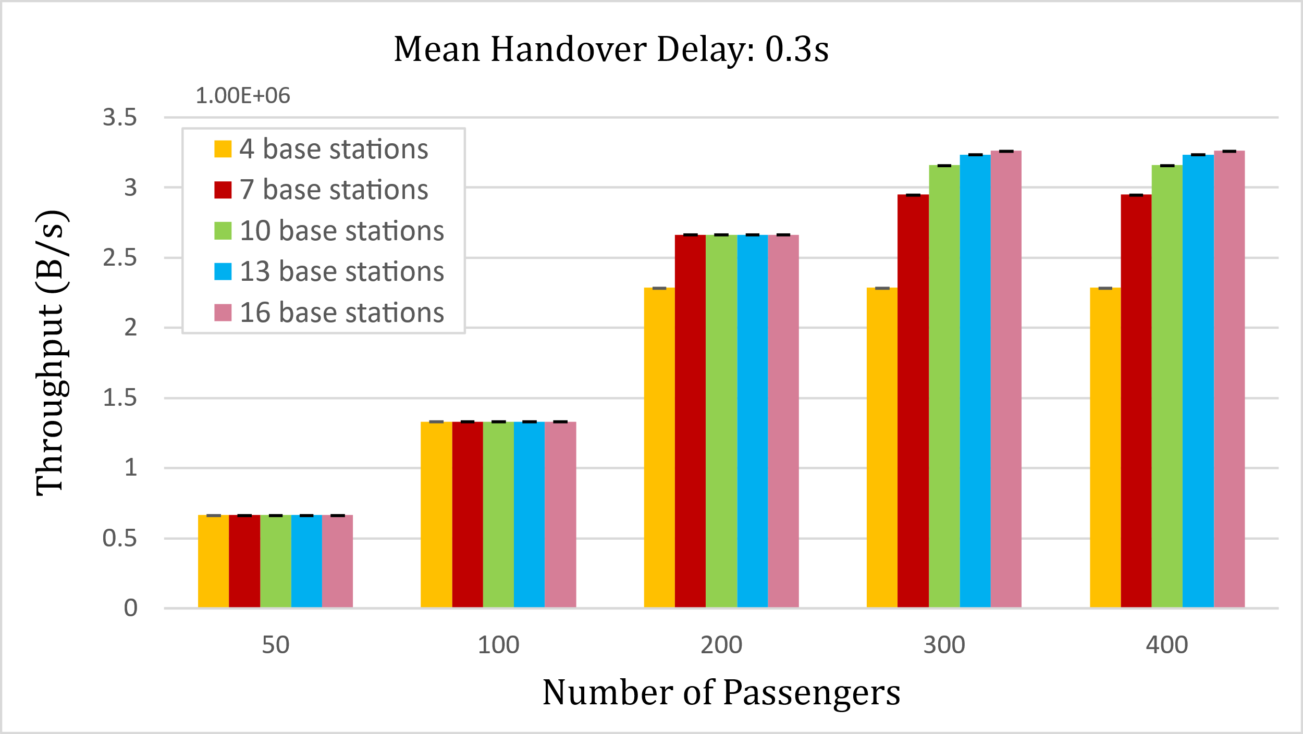
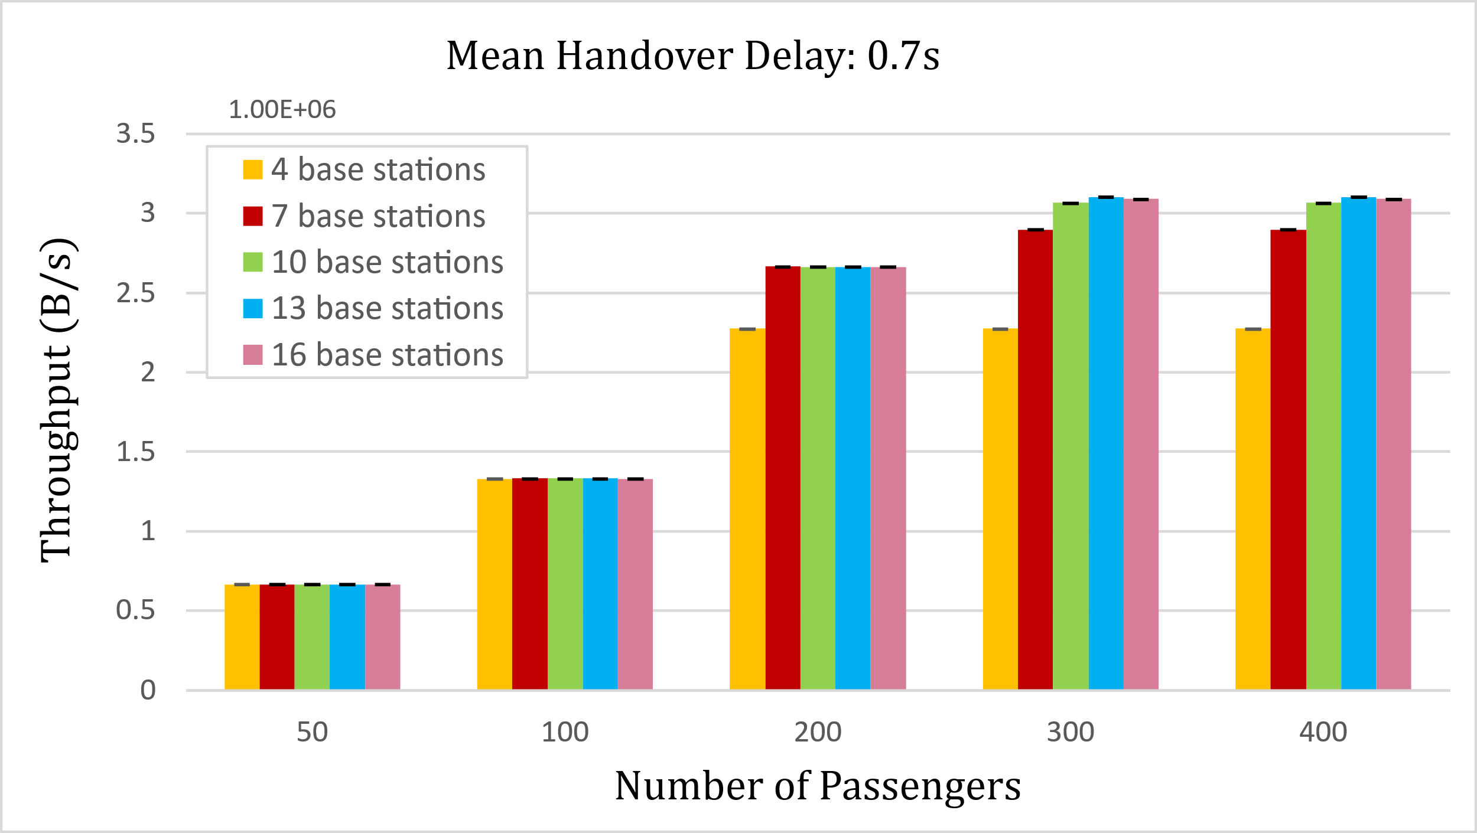
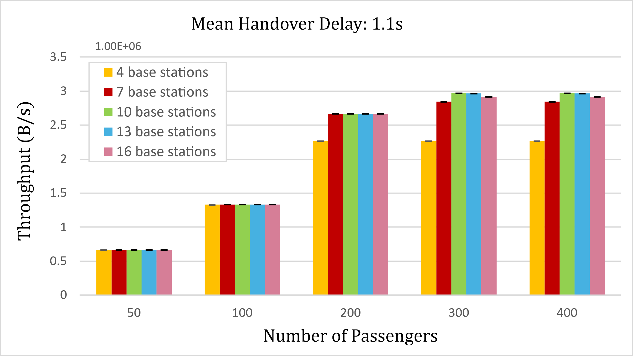
Experiments Design – Throughput Analysis

Slide 8
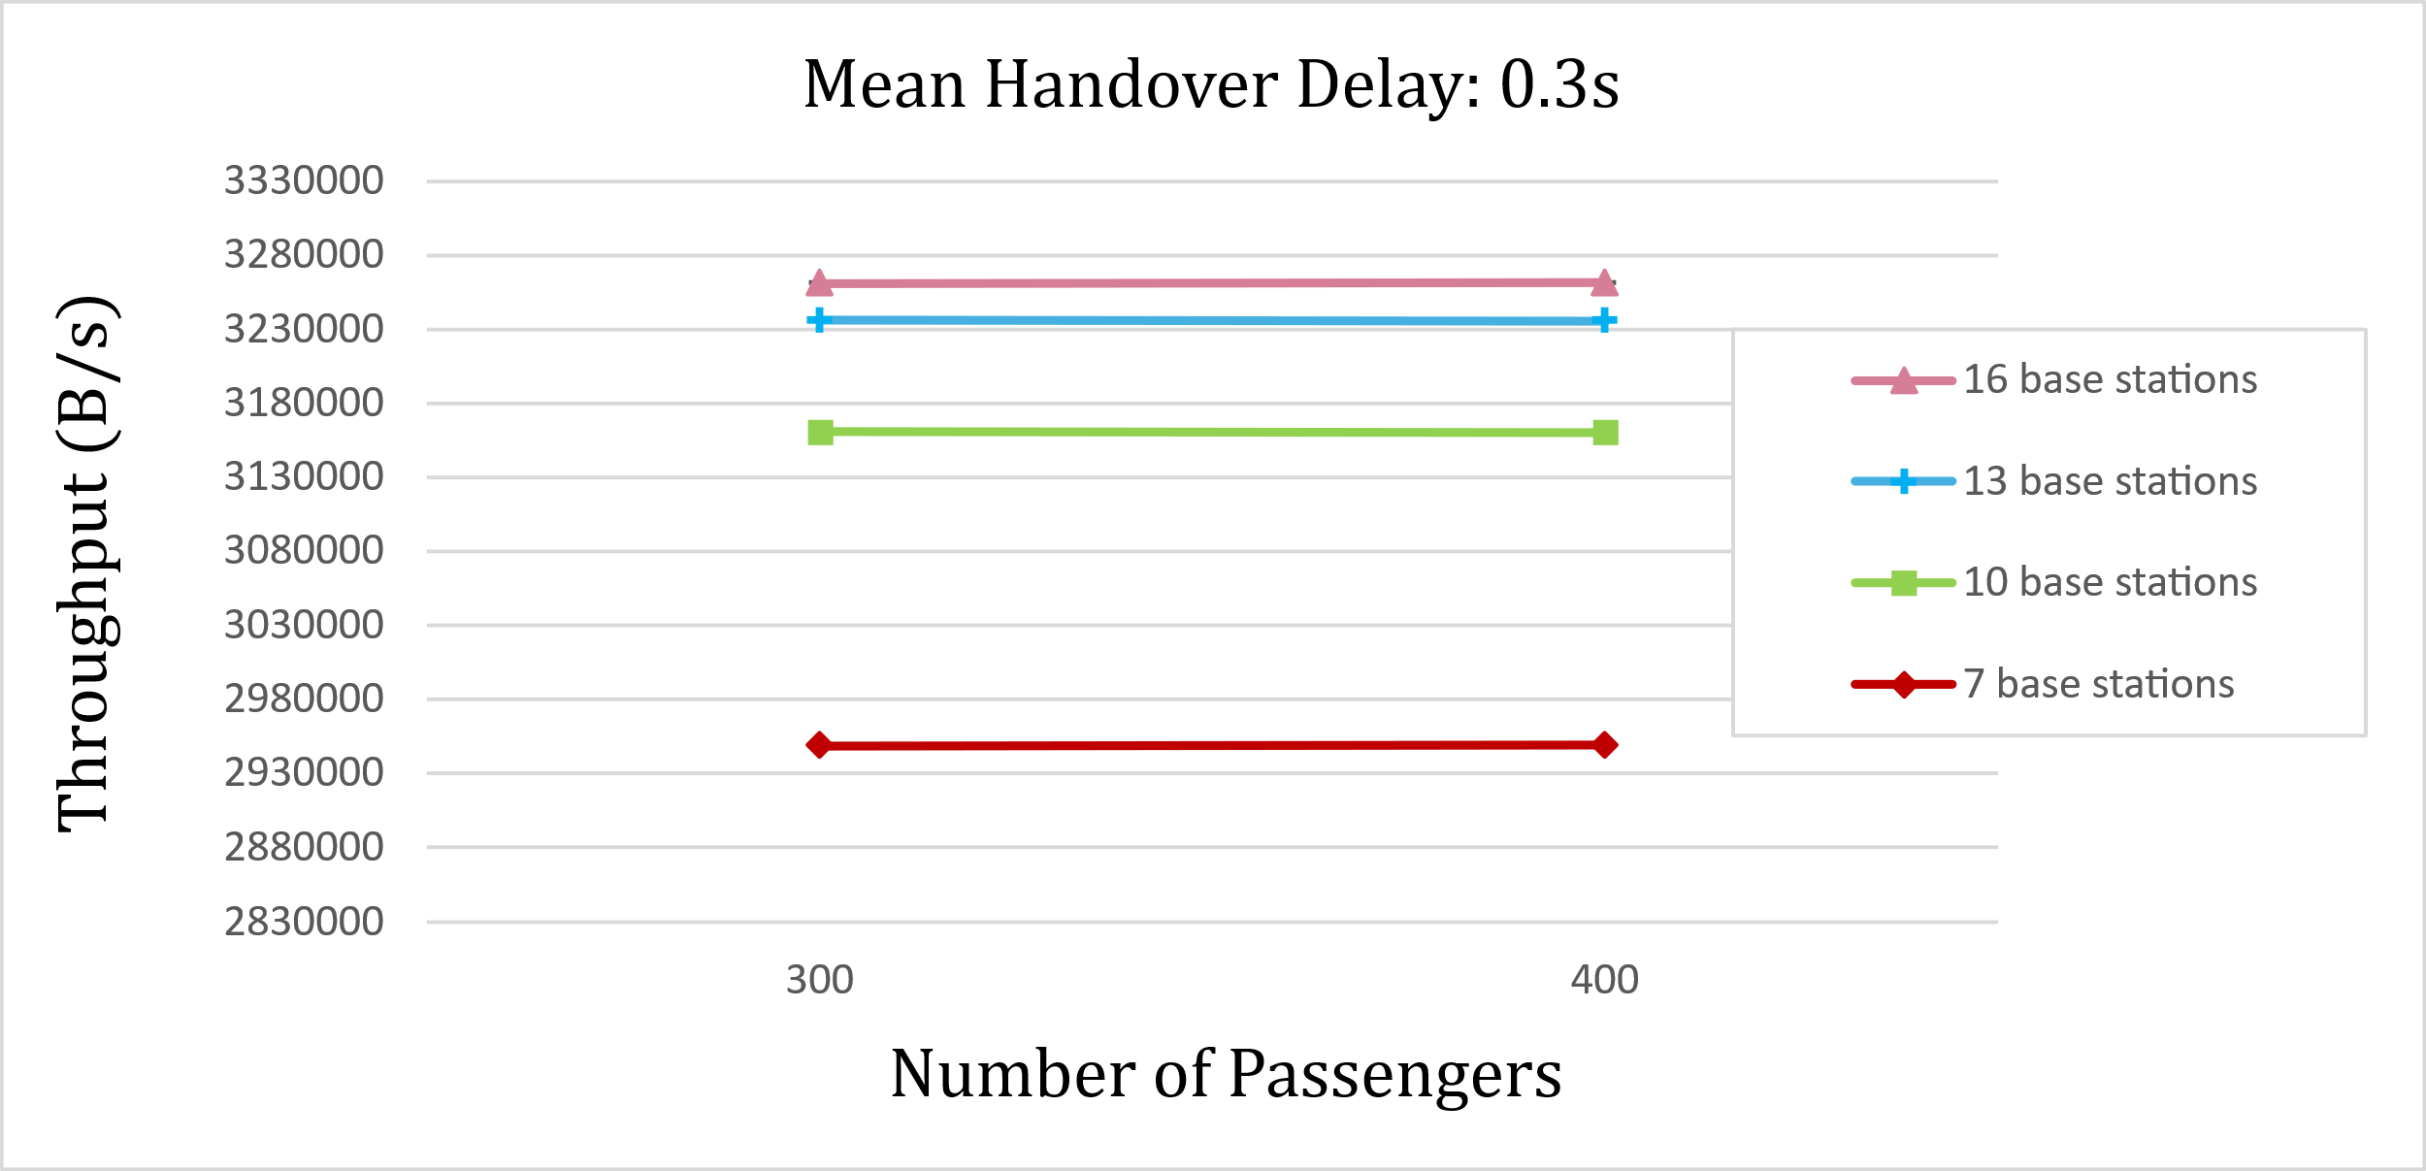
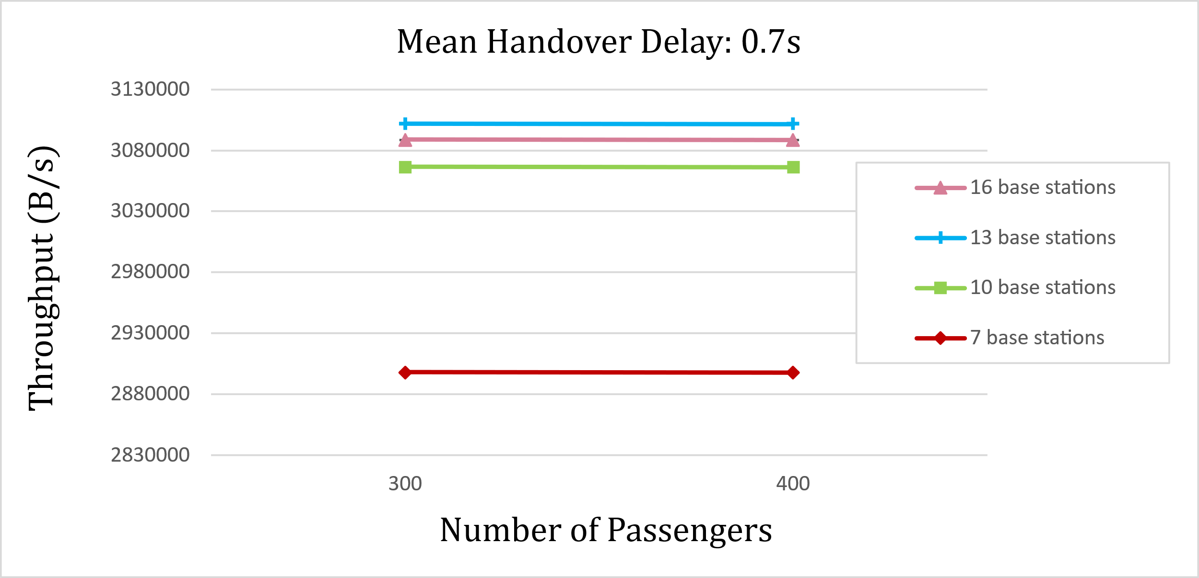
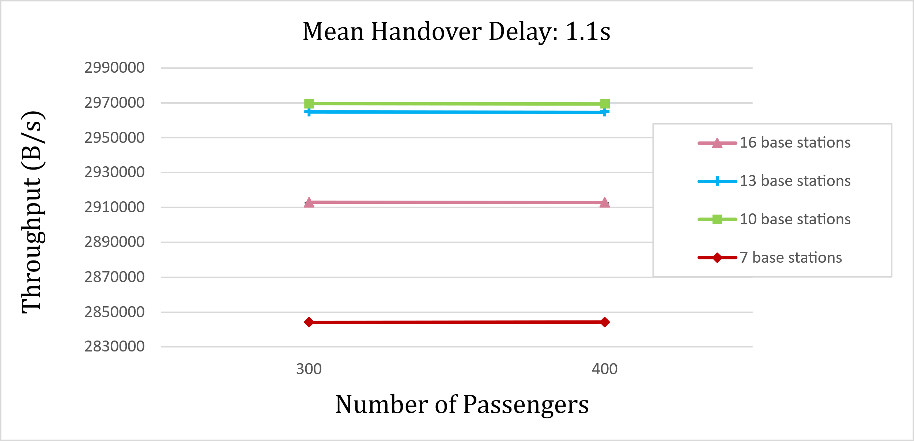
Experiments Design – High Load Scenario

Slide 9
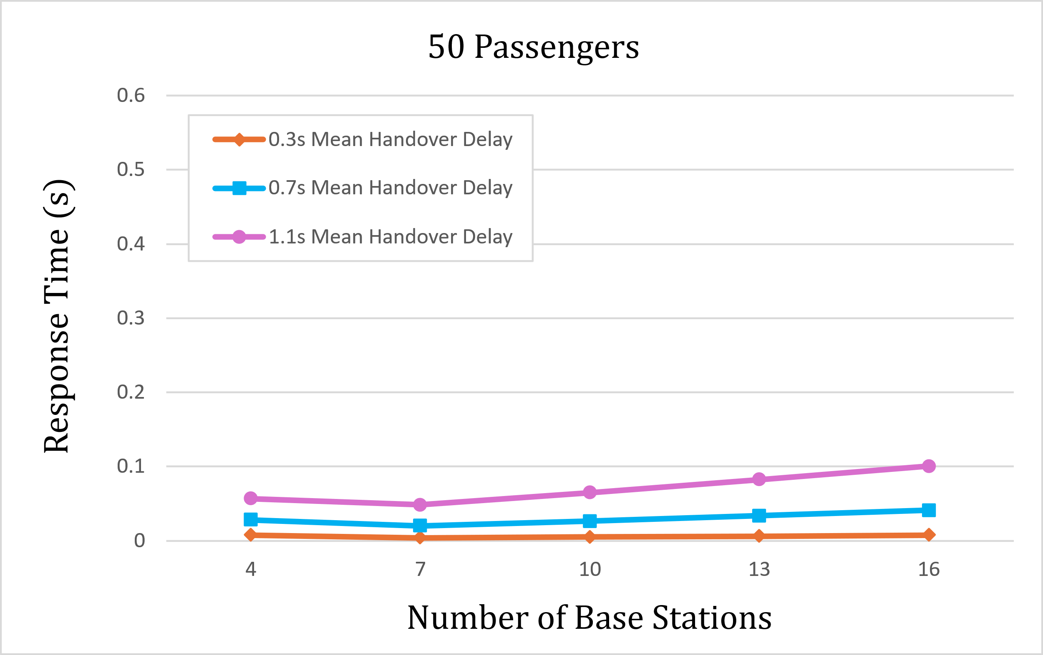
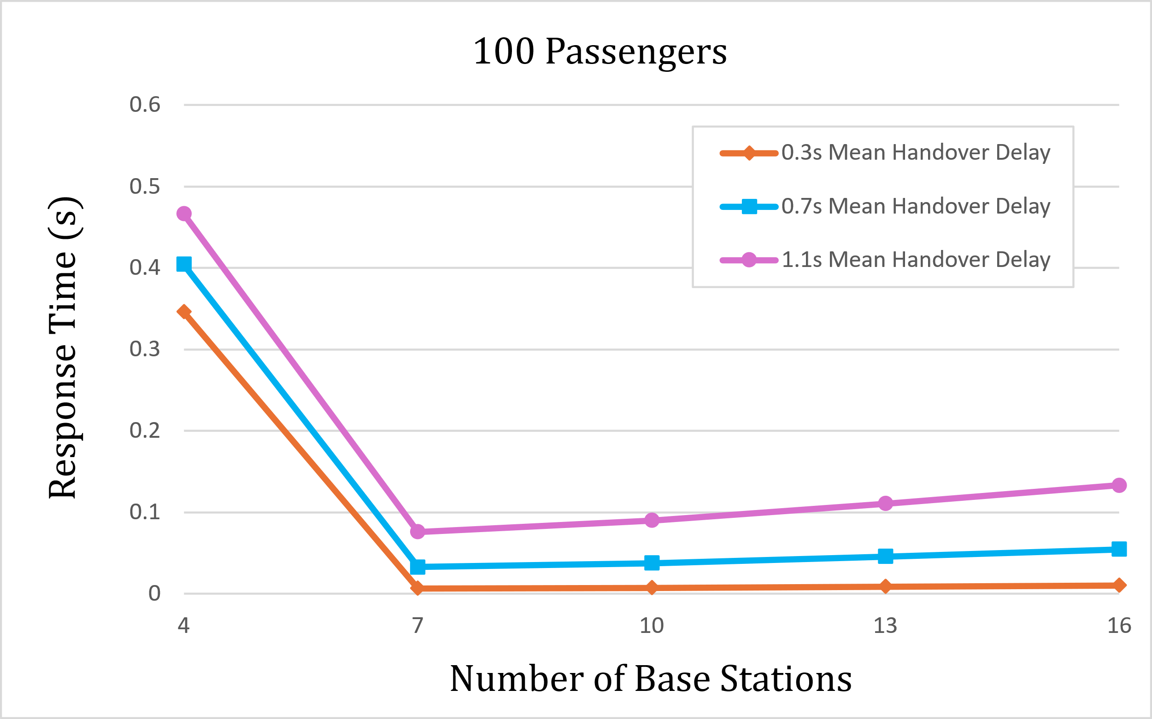
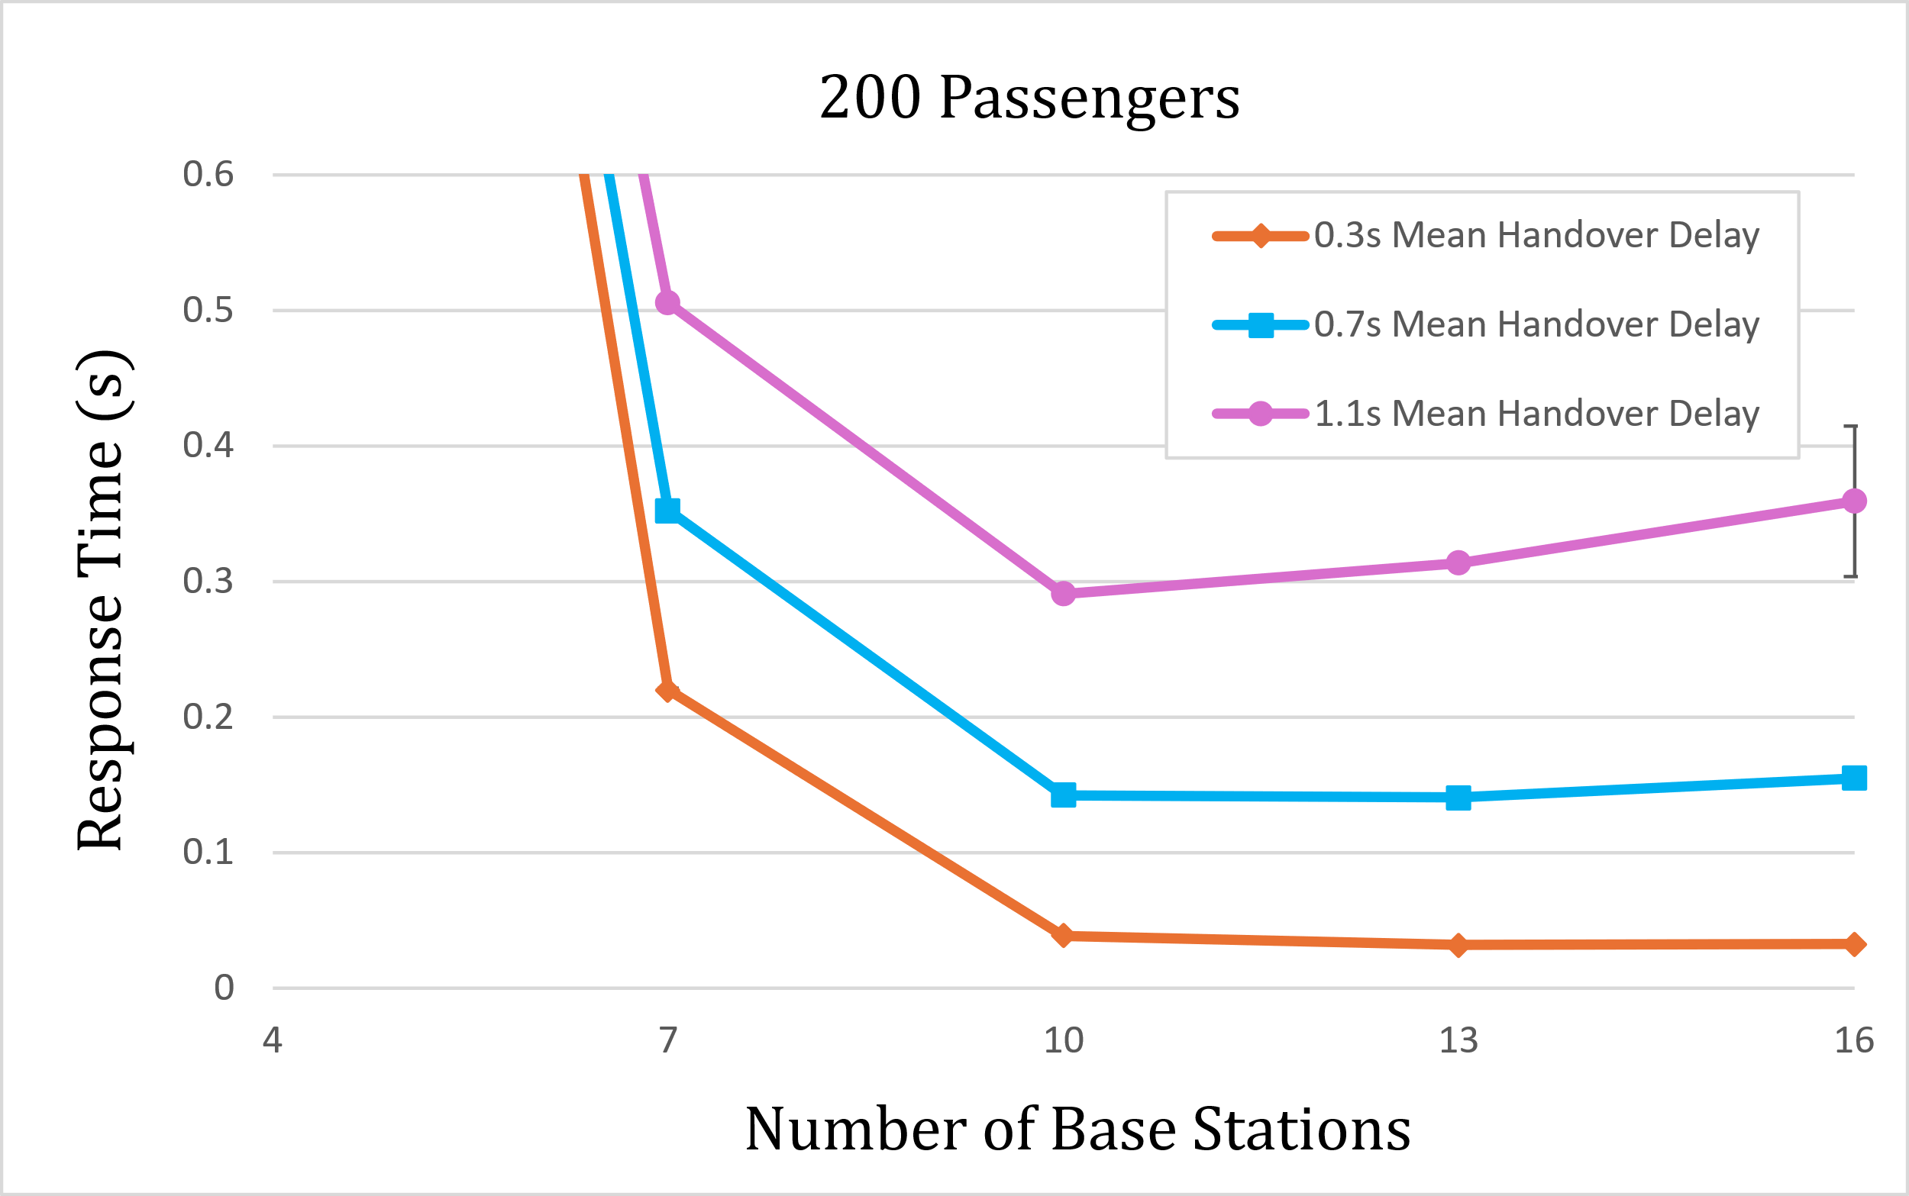
Experiments Design – Response Time Analysis

Slide 10
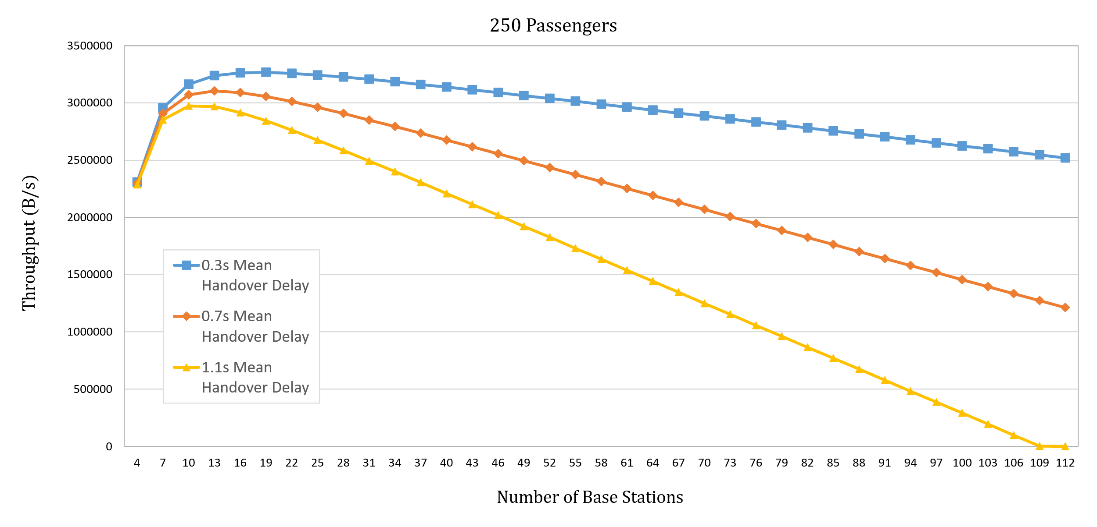
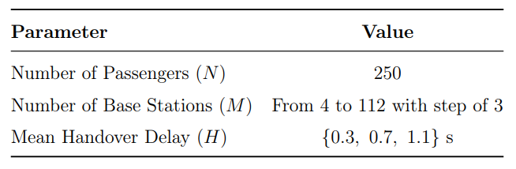
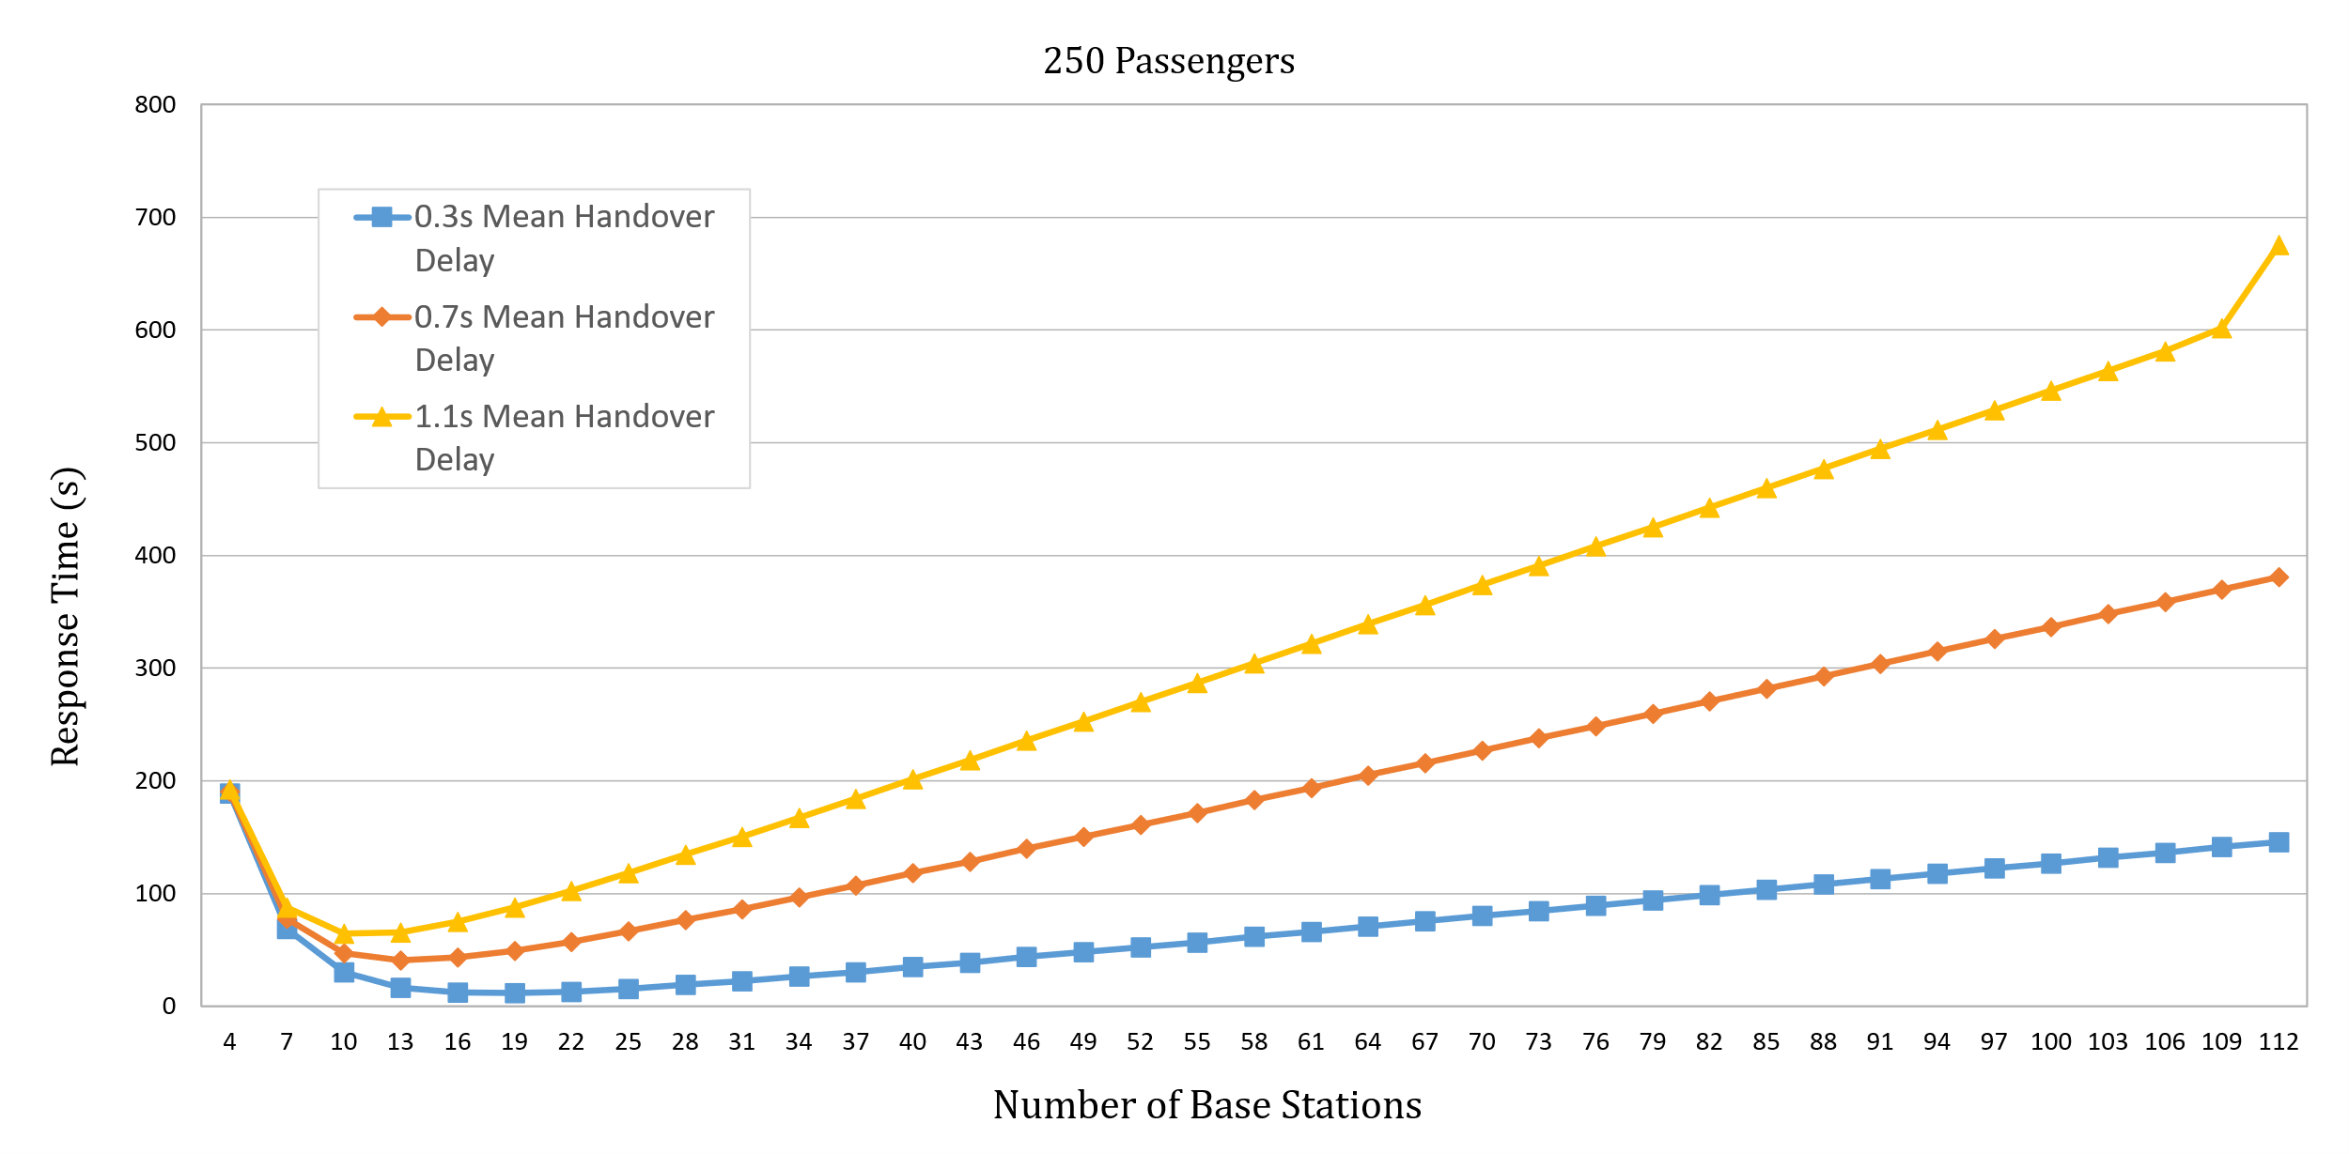
Experiments Design – Bell Analysis
Factors Bell Analysis
Interesting Observations
The peaks shift to the left as the mean handover delay increases
Non-linear behaviour up to the peak, followed by a linear trend
With a huge number of base stations, transmission stops altogether

Slide 11
Conclusions
This study provided an analysis of 5G Connected High-Speed Train, highlighting the critical need to balance infrastructure sizing (the number of base stations) with the delay introduced by handover operations.
Low Load
The system remains stable and throughput depends almost exclusively on the input rate
The throughput is a function of the number of passengers (N)
High Load
The system reaches saturation, with throughput limited by the maximum transmission capacity
Increasing the number of base stations improves performance only up to an optimal point, after which diminishing returns are observed.
As the mean handover delay (H) increases, the peak performance shifts towards configurations with fewer base stations.
The simulations confirm that there is no single absolute optimal configuration. Maximizing throughput and minimizing response times requires a trade-off between the number of BSs and handover frequency.

Slide 12
Thank you
for your attention

